Slide 1
Disease Control Priorities
3rd Edition
[Name]
[Event]
[Date]

Slide 2

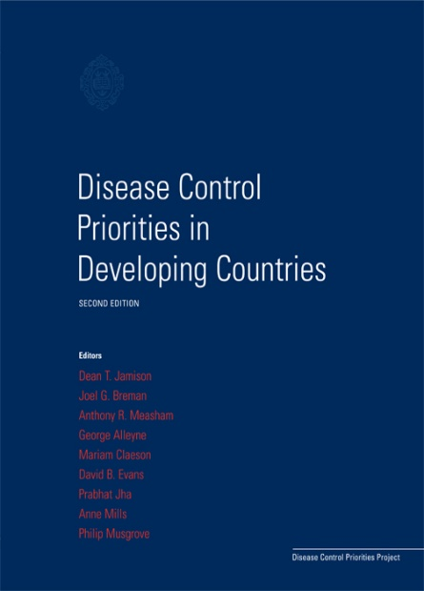
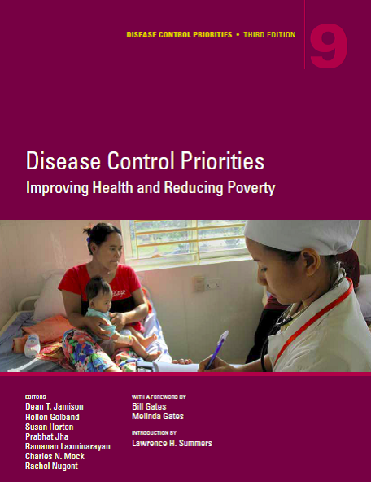
Disease Control Priorities History
1993 World Development
Report
Disease Control Priorities in Developing Countries, Second Edition 2006 (DCP2)
Disease Control Priorities, 3rd Edition 2015-2018 (DCP3)

Slide 3
Disease Control Priorities, 3rd Edition
DCP3 Volume Topics
Essential Surgery - 2015
2. Reproductive, Maternal, Newborn and Child Health -2016
3. Cancer - 2015
4. Mental, Neurological, and Substance Use Disorders - 2016
5. Cardiovascular, Respiratory, and Related Conditions - 2017
6. Major Infectious Diseases - 2017
7. Injury Prevention and Environmental Health - 2017
8. Child and Adolescent Health and Development - 2017
9. Disease Control Priorities: Improving Health & Reducing Poverty - 2018
@dcpthree | #dcp3
Notes:
Note, these are copyright dates. V9 will be launched in 2017 with a 2018 publication date.

Slide 4
DCP3 by the Numbers
9 Volumes
8 Years
33 Editors
500+ Authors
172 Chapters

Slide 5
DCP3 Overall
Summarize and synthesize evidence of the effectiveness and cost-effectiveness of global health interventions.
Strengthen capacity for evidence based priority-setting in global health.
Introduce new methods for assessing the equity and financial protection considerations of health interventions and policies.
@dcpthree | #dcp3

Slide 6
Multiple Volumes, Common Elements
9 DCP3 Volumes
Essential Packages
Intervention Effectiveness
Uniform Economic Evaluation
Policies & Platforms
Priority setting
Burden of Disease

Slide 7
Who is DCP3 for?
Policymakers
Researchers and Academics
Professional bodies and practitioners
Students
Global health funders and program implementers

Slide 8
Volume 1:
Essential Surgery
Editors:
Haile T. Debas
Peter Donkor
Atul Gawande
Dean T. Jamison
Margaret E. Kruk
Charles N. Mock
Published: March 2015
Notes:
Essential Surgery demonstrates surgery’s contribution to global public health. Data on the surgical burden of congenital anomalies, disease, disability, and trauma are presented, along with health and economic analyses of procedures, platforms, and packages to improve care in settings with severe budget limitations. Readers will gain comprehensive knowledge of the challenges and successes found in implementing surgical care strategies in low- and middle-income countries. Practitioners and researchers demonstrate that even small hospitals can deliver effective basic surgical services, and health care delivery structures already in place can be leveraged to provide affordable and quality surgical care.

Slide 9

Volume 2:
Reproductive, Maternal, Newborn, and Child Health
Editors:
Robert Black
Ramanan Laxminarayan
Marleen Temmerman
Neff Walker
Published: April 2016
Notes:
Reproductive, Maternal, Newborn, and Child Health (RMNCH) addresses conditions along the reproductive health continuum,
analyzing interventions that support healthy lives from adolescence, pregnancy care and delivery, until age five. This volume assesses
the global burden from RMNCH conditions; highlights cost-effective interventions to address maternal and child mortality; and describes
the economics and financing of care. Extensive systematic analyses indicate that scaling up interventions across the continuum can reduce maternal,
neonatal, and child deaths in low- and middle-income countries. They further suggest that investing in quality childbirth care and
family planning can lead to quadruple returns on investment by reducing maternal and neonatal mortality as well as stillbirths and disability.

Slide 10
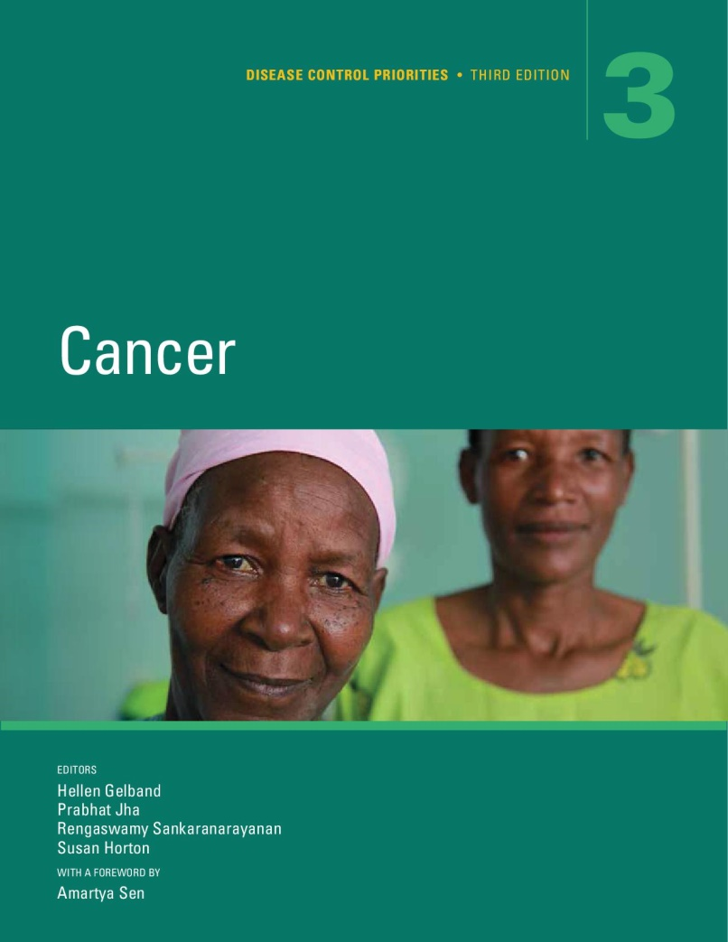
Volume 3:
Cancer
Editors:
Hellen Gelband
Prabhat Jha
Rengaswamy Sankaranarayanan
Susan Horton
Published: November 2015
Notes:
Cancer identifies effective, cost-effective, feasible, and affordable interventions to address the growing cancer burden
in low- and middle-income countries. Most tobacco- and infection-related cancers can be prevented. Many cancers can be treated. Cancer
reviews key issues in the expansion of cancer services in these countries, combining economic and epidemiological analyses. Nobel
Laureate Amartya Sen, in the foreword, observes, “The work of discovering and testing approaches to treatment has produced tangible
results, evident in cancer trends in high-income countries. The challenge of this Disease Control Priorities volume on cancer is to extend the
benefit to the rest of the world.”

Slide 11

Volume 4:
Mental, Neurological, and Substance Use Disorders
Editors:
Vikram Patel
Dan Chisholm
Tarun Dua
Ramanan Laxminarayan
Maria Elena Medina-Mora
Published: April 2016
Notes:
Mental, neurological, and substance use disorders are common, highly disabling, and associated with significant premature mortality. The impact of these disorders on the social and economic well-being of individuals, families, and societies is large, growing, and underestimated. Despite this burden, these disorders have been systematically neglected, particularly in low- and middle-income countries, with pitifully small contributions to scaling up cost-effective prevention and treatment strategies. Systematically compiling the substantial existing knowledge to address this inequity is the central goal of this volume. This evidence base can help policy makers in resource-constrained settings as they prioritize programs and interventions to address these disorders.

Slide 12
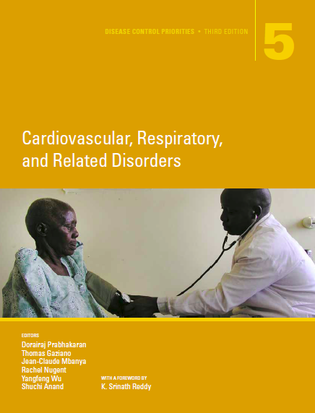
Volume 5:
Cardiovascular, Respiratory, and Related Disorders
Editors:
Dorairaj Prabhakaran
Shuchi Anand
Tom Gaziano
Jean-Claude Mbanya
Yangfeng Wu
Rachel Nugent
Notes:
Cardiovascular, respiratory, and related diseases and conditions, share a set of important risk factors. Conditions covered in this volume are closely related, share many risk factors, precursors and sequelae for the others, and therefore have common control measures. They are responsible for a large and growing share of health burden in the world – a burden that is rising especially fast in low- and low-middle income countries that are ill-equipped to prevent them. This volume summarizes the current knowledge and management strategies for conditions associated with the greatest burden, and for which there are interventions which are both effective and scalable. Our goal is to guide policy makers attempting to address the leading causes of death in the world.

Slide 13
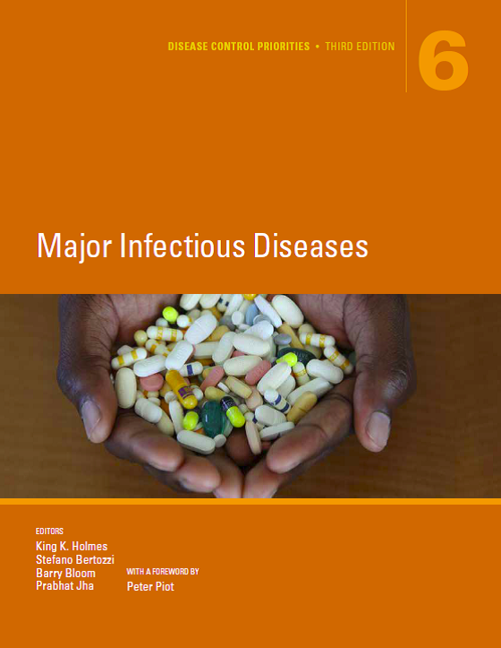
Volume 6:
Major Infectious Diseases
Editors:
King K. Holmes
Stefano Bertozzi
Barry R. Bloom
Prabhat Jha
Notes:
Taken together, infectious diseases are the leading cause of death globally, particularly among children and young adults. The ongoing emergence and spread of new pathogens and the growing threat of antimicrobial resistance make combating these diseases challenging. Major Infectious Diseases identifies feasible, cost-effective packages of interventions and strategies across delivery platforms for prevention and treatment of HIV/AIDS, other Sexually Transmitted Infections, Tuberculosis, Malaria, Adult Febrile Illness, Viral Hepatitis, and Neglected Tropical Diseases. The volume emphasizes the need for effectively addressing emerging Antimicrobial Resistance in pathogens causing Major Infectious Diseases strengthening health systems and increasing access to care and treatment with the goal of reducing incidence, developing novel, innovative approaches, and optimizing existing tools when and where resources are limited.

Slide 14
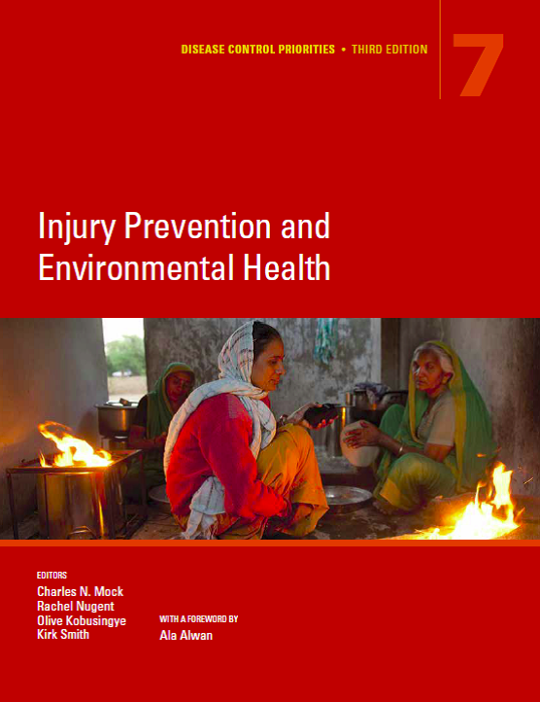
Volume 7:
Injury Prevention & Environmental Health
Editors:
Charles N. Mock
Rachel Nugent
Olive Kobusingye
Kirk R. Smith
Notes:
The substantial burden of death and disability that results from interpersonal violence, road traffic injuries, unintentional injuries, occupational health risks, air pollution, climate change, and inadequate water and sanitation falls disproportionally on low- and middle-income countries. Injury Prevention and Environmental Health addresses the risk factors and presents updated data on the burden, as well as economic analyses of platforms and packages for delivering cost-effective and feasible interventions in these settings. The volume’s contributors demonstrate that implementation of a range of prevention strategies―presented in an essential package of interventions and policies―could achieve a convergence in death and disability rates that would avert more than 7.5 million deaths a year.

Slide 15
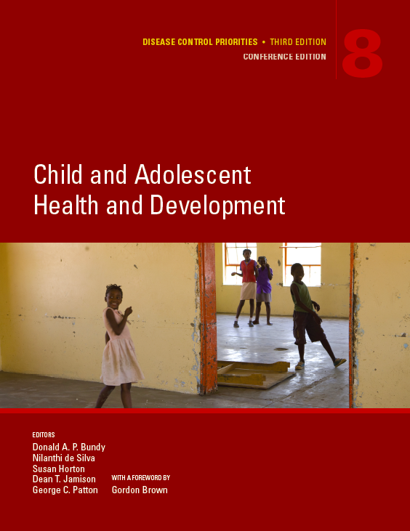
Volume 8:
Child and Adolescent Health and Development
Editors:
Donald A.P. Bundy
Nilanthi de Silva
Susan Horton
Dean T. Jamison
George C. Patton
Notes:
More children born today will survive to adulthood than at any time in history. It is now time to emphasize health and development in middle childhood and adolescence—developmental phases which are critical to health in adulthood and the next generation.
Child and Adolescent Health and Development explores the benefits that accrue from sustained and targeted interventions across the first two decades of life. The volume outlines the investment case for effective, costed, and scalable interventions for low-resource settings, emphasizing the cross-sectoral role of education. This evidence base can guide policy makers in prioritizing actions to promote survival, health, cognition and physical growth throughout childhood and adolescence

Slide 16
Volume 9:
Disease Control Priorities
Editors:
Dean T. Jamison
Hellen Gelband
Susan Horton
Prabhat Jha
Ramanan Laxminarayan
Charles N. Mock
Rachel Nugent
Notes:
Disease Control Priorities: Improving Health and Reducing Poverty places conclusions from the nine-volume series into a framework addressing the need for efficient pathways toward universal health coverage. This volume identifies 21 essential packages of health sector interventions and fiscal and intersectoral policies. This volume also extends DCP3’s discussion of health system responsibilities to include topics such as pathology, palliative care, quality of care, and pandemic preparedness. The 244 distinct health sector interventions identified in the construction of these packages constitute DCP3’s model for essential universal health coverage. Arguing in favor of efficient public financing of protection against financial risk as well as health, this volume contends that improving health and reducing poverty can be attained.

Slide 17
Other Areas of DCP’s Work

Slide 18
Policy Advocacy & Country Engagement
OBJECTIVES:
Support and advance the use of DCP data, methods, and messages for policy making and priority setting.
Work with country level partners in Ethiopia and one Eastern Mediterranean region country to apply DCP3 methods and results as relevant.
Increase demand for and acceptance of ECEA methods to incorporate financial risk protection and distributional consequences of health policies into economic evaluation.

Slide 19
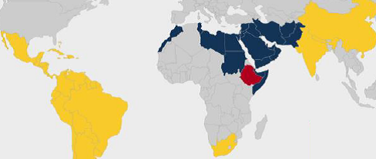
Policy Advocacy & Country Engagement
OUTPUTS:
High-level policy dialogues
on choosing priority
health issues.
Country-specific research to inform sector strategy
(South Africa, India, China, Ethiopia, select country in EMRO).
Capacity building workshops and research collaborations to build skills and evidence.

Slide 20
Current Work in Ethiopia and EMRO
Ethiopia
  Working with local researchers to apply economic evaluation methods to priority topics for national policymakers
WHO Eastern Mediterranean Region (EMRO)
  3 year collaboration to advance the application of DCP methods for priority setting at the regional and country level
  Approaches include building local capacity for health economic evaluation, facilitating a series of policy dialogues, and potentially conducting a “Country DCP” in one country
Notes:
This is just a condensed version of the previous two slides with a focus on our current work in Ethiopia and EMRO

Slide 21
Health Economics Methods Development
Extended Cost Effectiveness Analysis
Helps health policymakers understand how their decisions will differentially affect the rich and poor
Identifies ways to avoid poverty due to individuals paying for health services
Can assess equity between groups of interest (men/women, urban/rural, ethnic groups, etc.)

Slide 22
THANK YOU
Download: dcp-3.org
Order: worldbank.org/publications
@dcpthree
#dcp3
info@dcp-3.org

