Slide 1
Disease Control Priorities 3rd Edition REPRODUCTIVE, MATERNAL, NEWBORN & CHILD HEALTH
[NAME]
[AFFILIATION]
[EVENT OR MEETING]
[DATE]

Slide 2
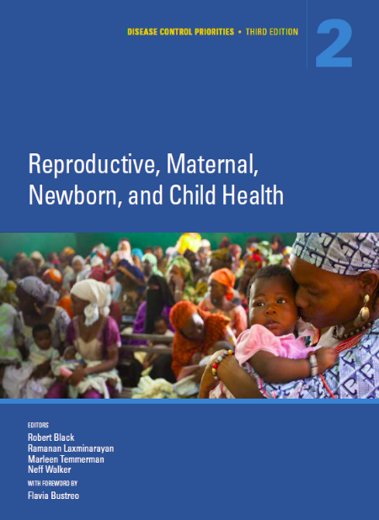
Disease Control Priorities History
1993 World Development
Report
Disease Control Priorities in Developing Countries, Second Edition 2006 (DCP2)
Disease Control Priorities, 3rd Edition 2015-2016 (DCP3)

Slide 3
Disease Control Priorities, 3rd Edition
DCP3 Volume Topics
Essential Surgery - 2015
2. Reproductive, Maternal, Newborn, and Child Health -2016
3. Cancer - 2015
4. Mental, Neurological, and Substance Use Disorders - 2015
5. Cardiovascular, Respiratory, and Related Disorders - 2016
6. HIV/AIDS, STIs, Tuberculosis, and Malaria - 2016
7. Injury Prevention and Environmental Health - 2016
8. Child and Adolescent Development - 2016
9. Disease Control Priorities and Universal Health Coverage - 2016
@dcpthree | #dcp3

Slide 4
Multiple Volumes, Common Elements
9 DCP3 Volumes
Costing of Essential Packages
Intervention Effectiveness
Uniform Economic Evaluation
Policies, Platforms & Packages
Universal Health Coverage
Burden of Disease
@dcpthree | #dcp3

Slide 5
DCP3 Overall
Summarize and synthesize evidence of the effectiveness and comparative evaluation of global health interventions.
Strengthen the capacity of evidence based priority-setting in global health.
Introduce new methods for assessing the equity and financial protection considerations of health and policy.
@dcpthree | #dcp3

Slide 6
Volume 2: Reproductive, Maternal, Newborn & Child Health
Editors:
Robert Black
Marleen Temmerman
Neff Walker
Ramanan Laxminarayan

Slide 7
RMNCH Key Messages
There have been large reductions in annual number of maternal and child deaths in the last 25 years, yet for many countries the rate of reduction has been too slow to achieve MDG Goal 4 and 5 by 2015.
Progress could be accelerated by scaling up integrated packages of essential RMNCH interventions across the continuum of care. These interventions are highly cost-effective and result in benefit-cost ratios of 7-11 by 2015.
@dcpthree | #dcp3

Slide 8
RMNCH Key Messages Cont.
Scaling up interventions in the 3 packages, except contraceptive services to 90% coverage would avert 139,000 maternal deaths, 781,000 stillbirths, and 1.8 million child deaths.
Individual interventions that have the highest impact on deaths are provision of contraception, management of labor and delivery, care of preterm births, treatment of severe infectious diseases, and management of severe acute malnutrition.
@dcpthree | #dcp3

Slide 9
THANK YOU
More information: dcp-3.org/RMNCH
Twitter: @dcpthree
#DCP3

